Slide 1


CAPSTONE PROJECT PRESENTATION ON
VEHICLE SPEED DETECTION
Presented By Thiyaneshwar K

Slide 2

Introduction | 3
Problem Statement | 4
Methodology | 5
Working | 6
Flow chart | 7
Framework | 8
Challenges | 9
Conclusion | 10
References | 11
AGENDA

Slide 3
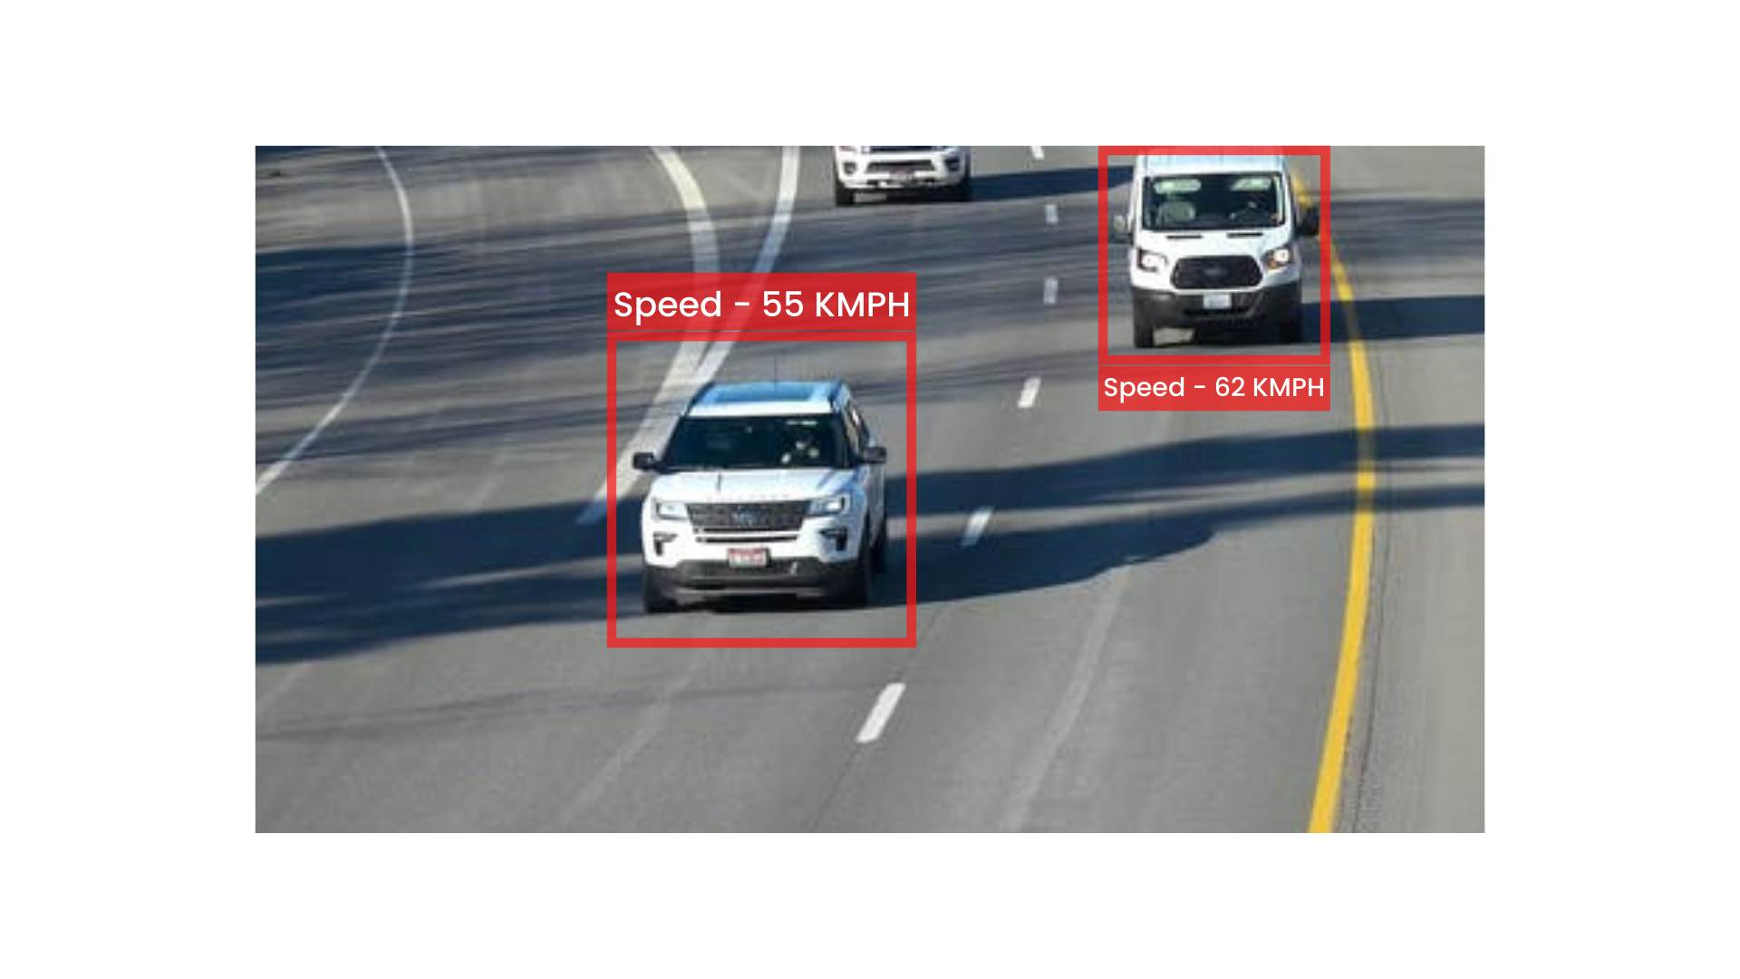

Introduction
Although there is good road safety performance, yet the numbers of people killed and injured on our roads remain unacceptably high. The main reason is excess speed of vehicles.
We use traffic lights and other traffic managers to reduce the speed. One among them is speed cameras. Speed cameras on the side of urban and rural roads are usually placed to catch transgressors of the stipulated speed limit for that road.
Laws are passed making excessive speed an offence. The speed cameras are used to identify those drivers that pass by them when they exceed the stipulated speed limit
Back to Agenda

Slide 4

Problem Statement
Road Safety Challenge: Increasing road accidents due to speeding vehicles and poor driving conditions require a robust solution.
Solution
Real-Time Speed Detection: Develop a computer vision-based system using Haar-like features and cascade classifiers to detect vehicle speeds in real-time, alerting drivers to potential risks and enhancing road safety.
Back to Agenda

Slide 5
Back to Agenda
METHODOLOGY
INPUT VIDEO HANDLING | OBJECT DETECTION | OBJECT TRACKING | SPEED CALCULATION
DATA LOGGING | REAL-TIME VIDEO FEED & USER INTERFACE | CLEANUP AND RELEASE | INTEGRATION WITH MACHINE LEARNING

Slide 6
Back to Agenda
WORKING
FILE UPLOAD
Users upload a video file in MKV, MP4, or AVI format via a web interface built with Flask.
DATA LOGGING
Information about detected vehicles, including dimensions and speeds, is logged into CSV files (vehicle.csv and cars.csv) for future analysis.
VIDEO PROCESSING
The uploaded video is processed frame by frame using OpenCV.
LIVE VIDEO FEED & USER INTERACTION
The processed video frames are streamed in real-time through the web interface, allowing users to view the video with speed information.
OBJECT TRACKING
Dlib's correlation tracking is applied to monitor the movement of detected vehicles across frames.
PERFORMANCE METRICS
Frames per second (FPS) are computed displayed on the video feed to evaluate the processing speed of the system.
SPEED CALCULATION
Vehicle speed is calculated in real-time based on the distance.
RESOURCE CLEANUP
Proper resource release and cleanup are ensured video processing is completed or when the user exits the application.

Slide 7
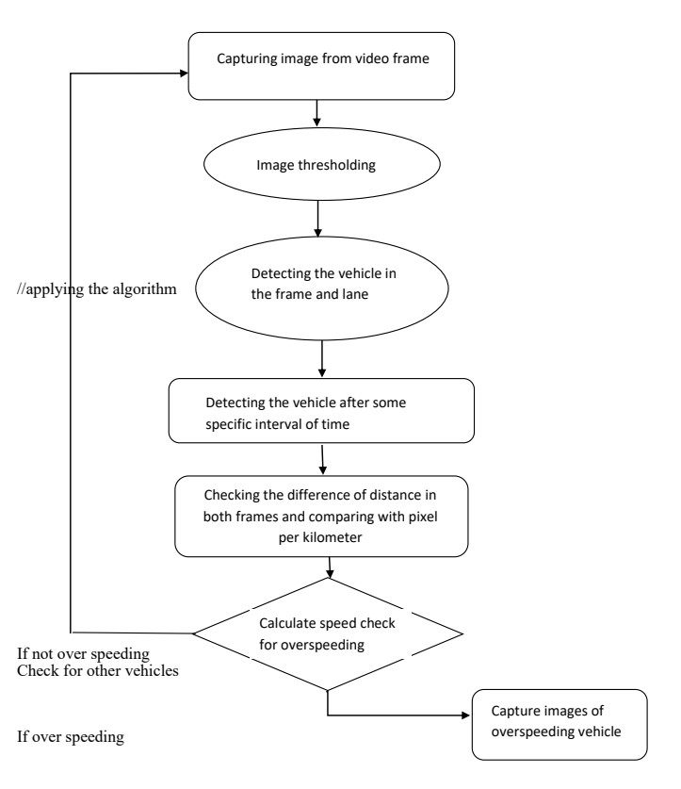
FLOW CHART
Briefly elaborate by visually on what we do
Back to Agenda

Slide 8
FRAMEWORK
Briefly elaborate on how we will implement and deployment the project.
DLIB
Dlib
OPENCV
OpenCV
WERKZEUG
Dlib is used for object tracking, specifically the correlation tracking of vehicles across frames.
Werkzeug's
OpenCV (Open Source Computer Vision Library) is employed for various image and video processing tasks, including vehicle detection, frame resizing, and real-time video streaming
Flask
Werkzeug's utility functions are utilized, particularly secure_filename, for secure file uploads.
Flask is used to create a web application for uploading video files and displaying the real-time video feed with speed annotations.
Back to Agenda
Back to Agenda

Slide 9
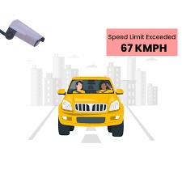
Challenges
Sometimes, the dlib correlation tracker fails when the scale of the object keeps on changing.
The estimated speed is not so authentic because of the expensive scanning and processing time.
A good resolution camera ought to be used for predicting non-erroneous license plate characters. Neural Enhance – Super Resolution of images (Deep Learning) can also be used, instead. However it increases the processing time.
Some unique vehicle cannot be identified because the machine is trained using only new models of vehicle.
Back to Agenda

Slide 10
Conclusion
We finally have a solution to the speeding problem.
We would expect there to be a great number of these every were and that day would be highly visible and identifiable to make a drivers slow down.
We use traffic lights and other traffic manager to reduce the speed. One among them is speed cameras.
Back to Agenda

Slide 11
R. Cancela, M. Neta, M. Oliveira, V. Santos, 2006. ATLAS III: Um Robô com Visão Orientado para Provas em Condução Autónoma, Robótica, nº 62, 2006, p. 8 (ISSN: 0874-9019).
M. Oliveira, V. Santos , A Vision-based Solution for the Navigation of a Mobile Robot in a Road-like Environment, Robótica, nº69, 2007 p. 8 (ISSN: 0874-9019).
M. Oliveira, V. Santos. Combining View-based Object Recognition with Template Matching for the Identification and Tracking of Fully Dynamic Targets, 7th Conference on Mobile Robots and Competitions, Festival Nacional de Robótica 2007. Paderne, Algarve. 27/04/2007
G. Monteiro, P. Peixoto, U. Nunes, 2006. Vision-based Pedestrian Detection using Haar-like Features. Encontro Científico, Festival Nacional de Robótica 2006.
R. Lienhart and J. Maydt. An Extended Set of Haar-like Features for Rapid Object Detection. IEEE ICIP 2002, Vol. 1, pp. 900-903, Sep. 2002.
Opencv, Intel Open Source Computer Vision, found at http://www.intel.com/technology/computing/Opencv/ on January 2007.
References
Back to Agenda

Slide 12
THANK YOU
Back to Agenda
Back to Agenda

